Slide 1

SyriaTel Churn Analysis
Carrie Liu
December 27, 2021

Slide 2
CONTENT
Overview
Our Approach
Primary Determinants of Churn
Recommendations
Best Mode

Slide 3
OVERVIEW
SyriaTel, a telecommunication company with customers across the United States.
It is suffering from a loss of valuable customers to competitors.
Our team is hired to build a classification model and determine the primary features that lead to the churn of customers.
The datasets include 3333 customers in 51 states (including D.C.) on a monthly basis.
14.5% Customers will churn based on current dataset.

Slide 4
Perform exploratory data analysis on current data
Build up baseline model using logistic regression
Apply multiple machine learning algorithms to build the best classification model
Find the primary determinants of churn
OUR APPROACH

Slide 5
CLASSIFICATION METHODS
K-Nearest Neighbors
Decision Tree
Random Forest
Boosting Strategies
Support Vector Machines
NOTES:
The above boosting strategies include AdaBoost, Gradient Boost and XGBoost (i.e., Extreme Gradient Boost)
We applied SMOTE (Synthetic Minority Over-sampling Technique) for unbalanced datasets.
We reduced regularization in the modeling.
We performed GridSearchCV in the final tuning.

Slide 6
BEST MODEL – Tuned XGBoost
Accuracy Score = 96%
Precision Score = 93%
Recall Score = 80%
F1 Score (comprehensive) = 96%
AUC = 0.91

Slide 7




PRIMARY DETERMINANTS
Customer Service Calls
Total Day Minutes
International Plan and Voice Mail Plan
Monthly Charges

Slide 8
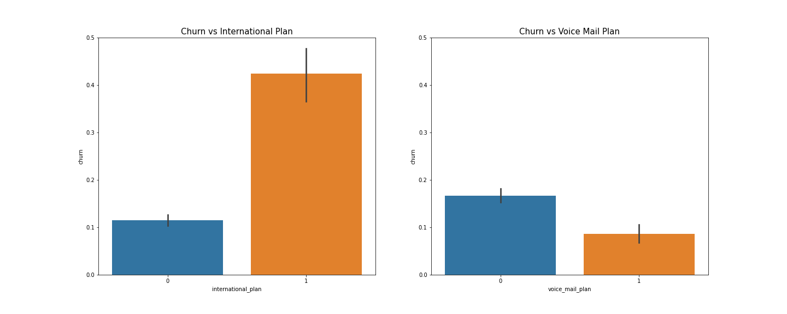
INTL PLAN & VOICE MAIL PLAN

Slide 9
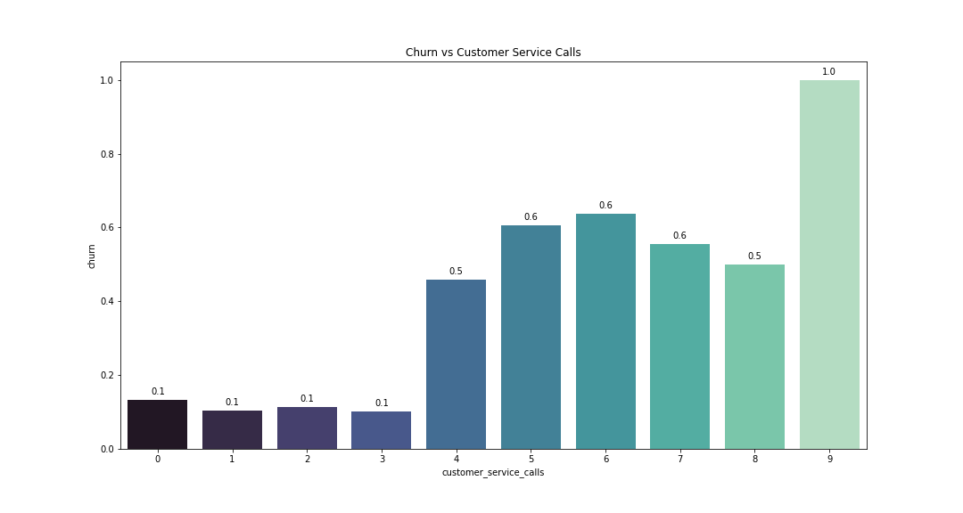
CUSTOMER SERVICE CALLS

Slide 10
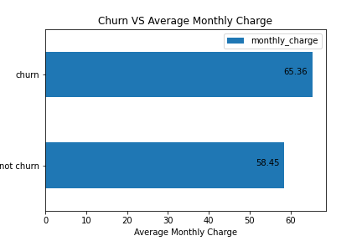
MONTHLY CHARGE
Monthly Charge
= Total Day Charge
+ Total Eve Charge
+ Total Night Charge
+ Total Intl Charge
Average Monthly Charge = $59.5
Max Monthly Charge = $96.2
Min Monthly Charge = $22.9

Slide 11
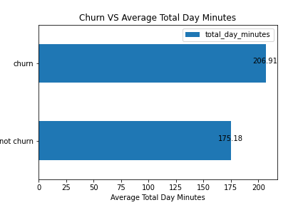
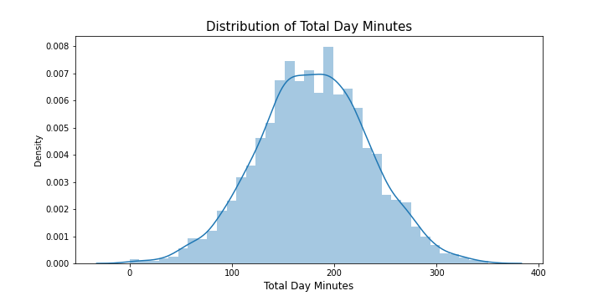
TOTAL DAY MINUTES

Slide 12
RECOMMENDATIONS
Market research on competitors and industry benchmark
Customer experience measurement and design
Partnership with local carriers

Slide 13
Thank you!

